Slide 1
EpsilonGov
Project - BetaGov
Team
Henry Lin
Nurvirta Monarizqa
Shay Lehmann
Priyanshi Singh
Achilles E A Saxby

Slide 2
What the Prosecutor really needs can be found right here
Visualization is Everything

Slide 3
Project Flow
Data
BetaGov
DA’s Office
Data Working
Data Cleaning
Data Reduction
Data Aggregation
Spatial Analysis
Zip-Code - Mapping
Cases Mapping
Most Prominent Cases
Heat Maps
Time Analysis
Weekday
Month

Slide 4
Data Working Stage
Data Working has been an integral part of this Hackday - Data Changing and Reordering
Data Cleaning
The usual Data cleaning procedures
Checking the shape and viable columns
Deleting the “ “ and “NaN” values
Data Reduction
Deleting Irrelevant data points: (after consultation with BetaGov and the DA’s Office)
Extradition
Forfeiture - Normal, Property, Civil
DA Case Status
Reviewing Prosecutor
VW Assigned
Data Aggregation
Aggregating via Zip-Codes
Aggregating via Time
Aggregating via Counts and Most Prominent

Slide 5
Time Analysis Stage
Time Analysis - Monthly
Time Analysis - Weekly

Slide 6
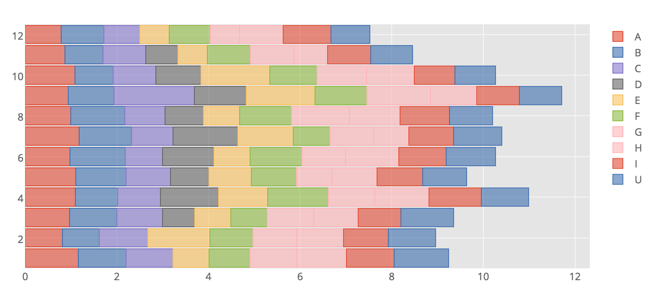
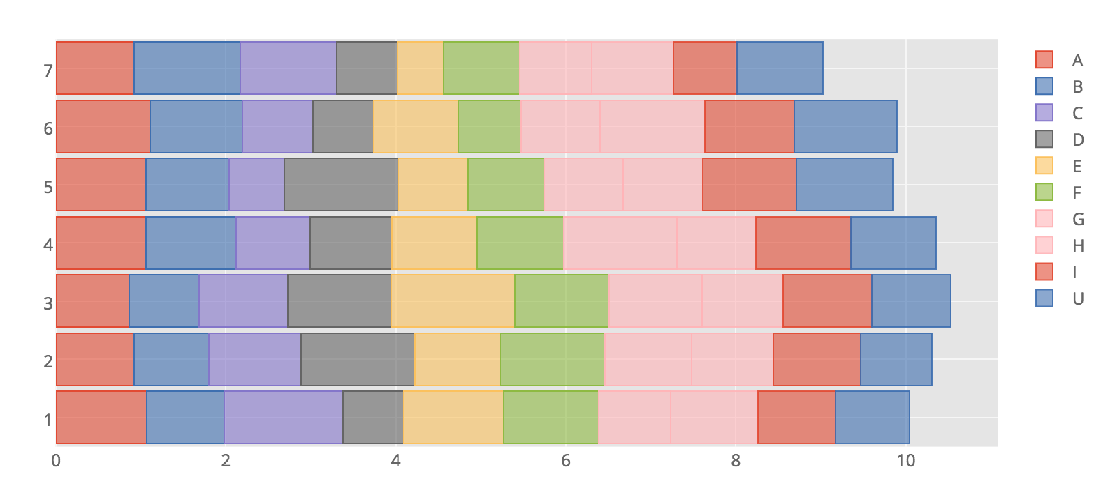
Time Analysis Stage
Monthly
Weekly

Slide 7
Spatial Analysis
Zip-Code Counts Mapping- Severity/Class
Prominent Cases
Heat Maps

Slide 8
Severity - Class
This section is based on a look at the total counts of the Severity - Class relationship (Class ⊂ Severity)
Data Aggregated on a Zip-Code level
Segregated and Grouped by Total Counts
Plotted on Severity, and each Class in Severity
Distributed on Quantiles
Segregated into 5 groups to show the variations between each zip-code
‘Incident Zip’ - Zip-Code where the incident occurred
‘Defendant Zip’ - Zip-Code where the defendant resides
All the visualizations and plots on the Severity/Class case, have been created based on the “Incident Zip”

Slide 9
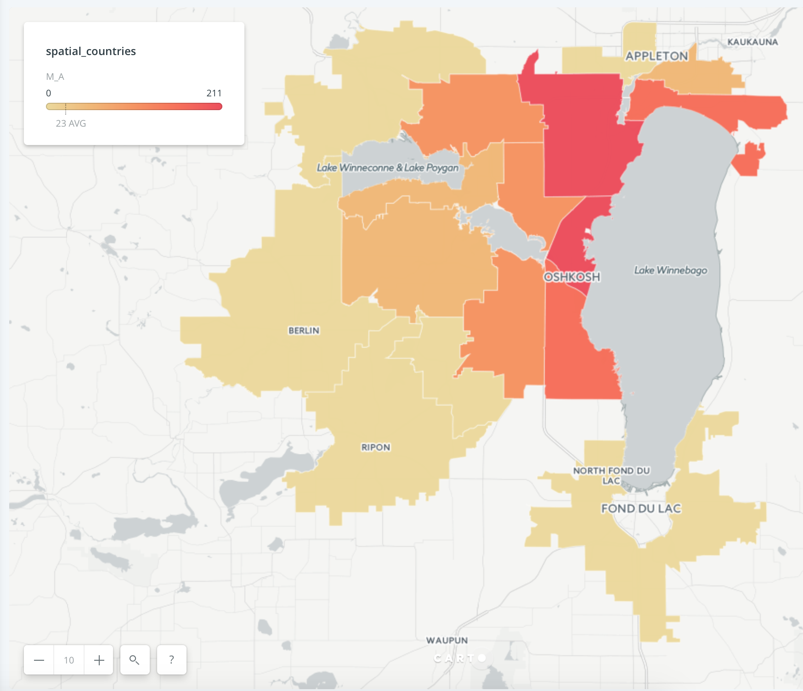
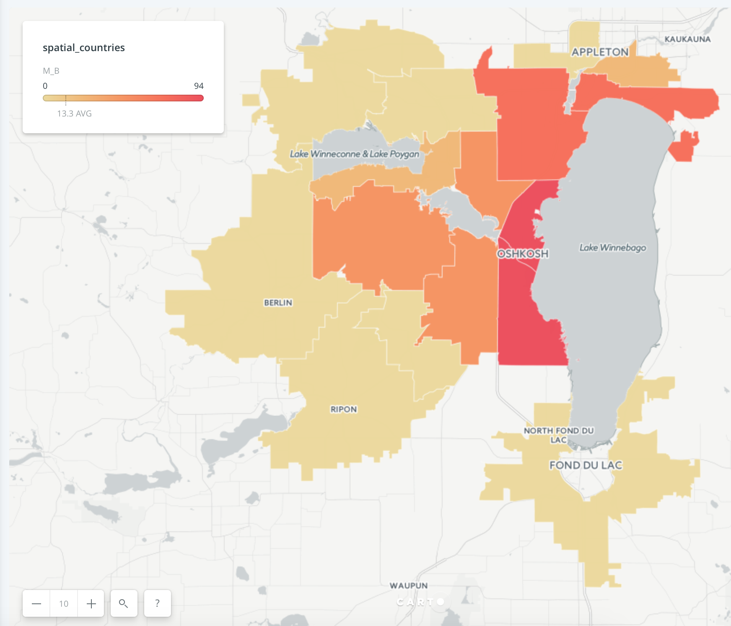
Severity - Class
Misdemeanor (M) - Class (A) + Class (B)
M_A - Obstructing or Resisting an Officer | (211) | Highest Counts in Misdemeanor
M_B - Disorderly Conduct | (94) - Second Highest Counts for Misdemeanor

Slide 10
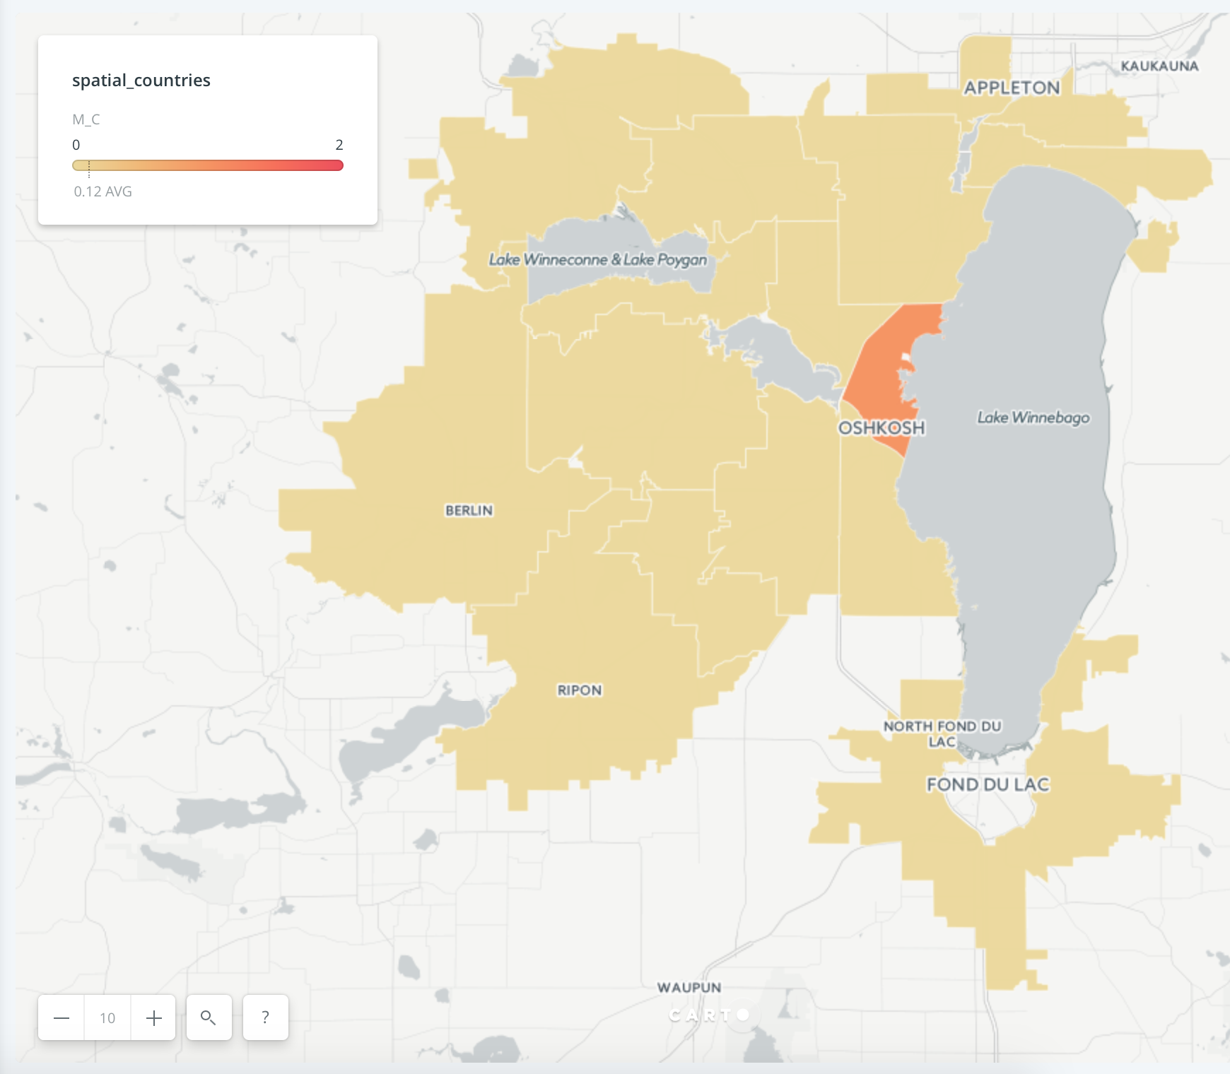
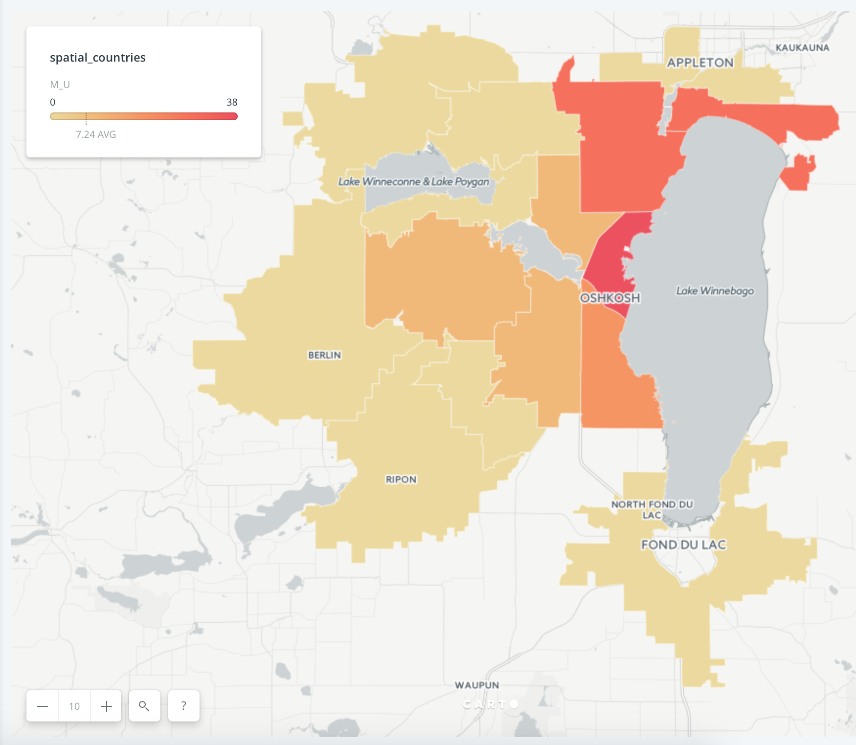
Severity - Class
Misdemeanor (M) - Class (C) + Class (U)
M_C - Contributing to Truancy | (2) | Not going to School
M_U - Possession of Cocaine | (38) - Third Highest Counts for Misdemeanor

Slide 11
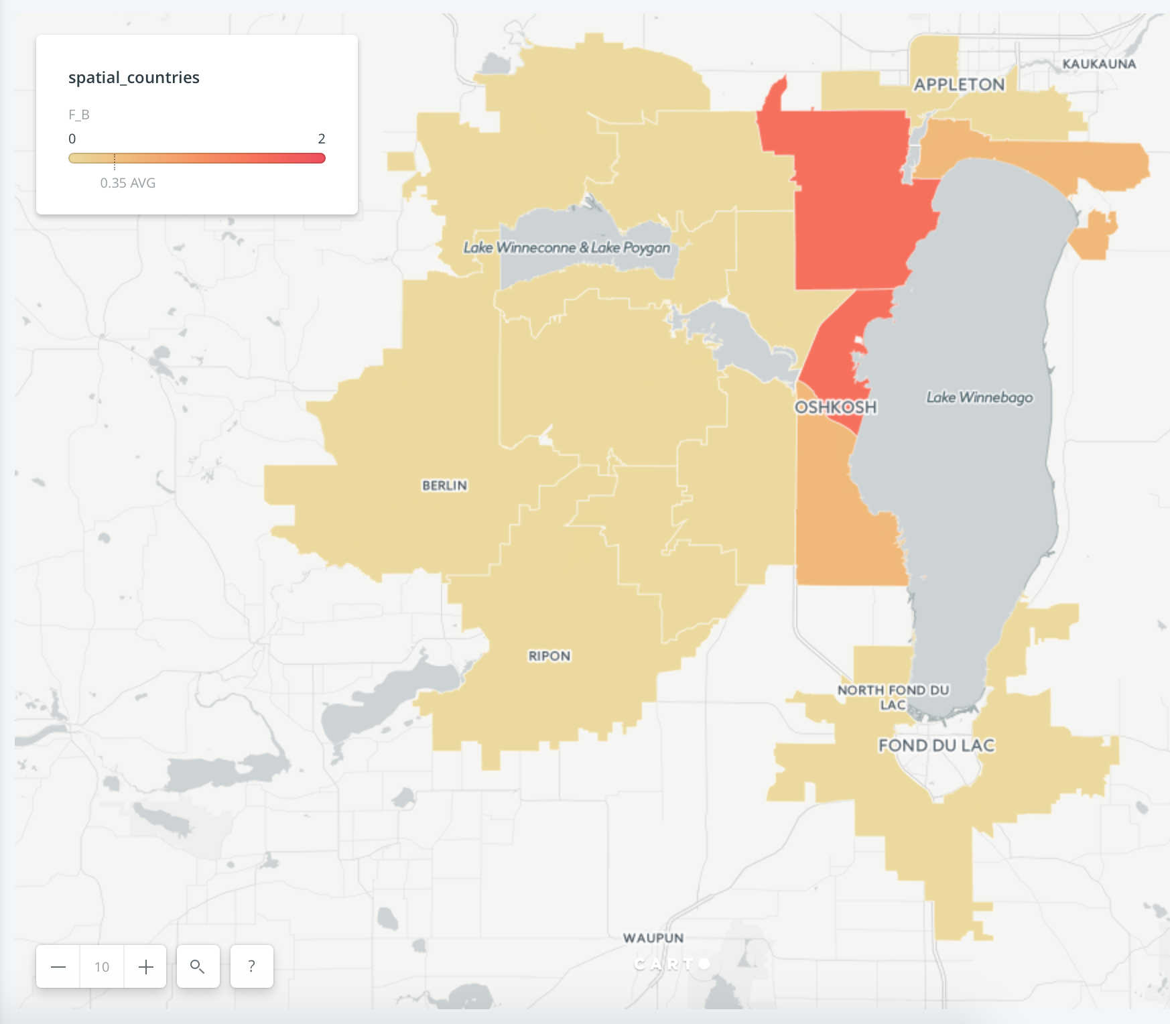
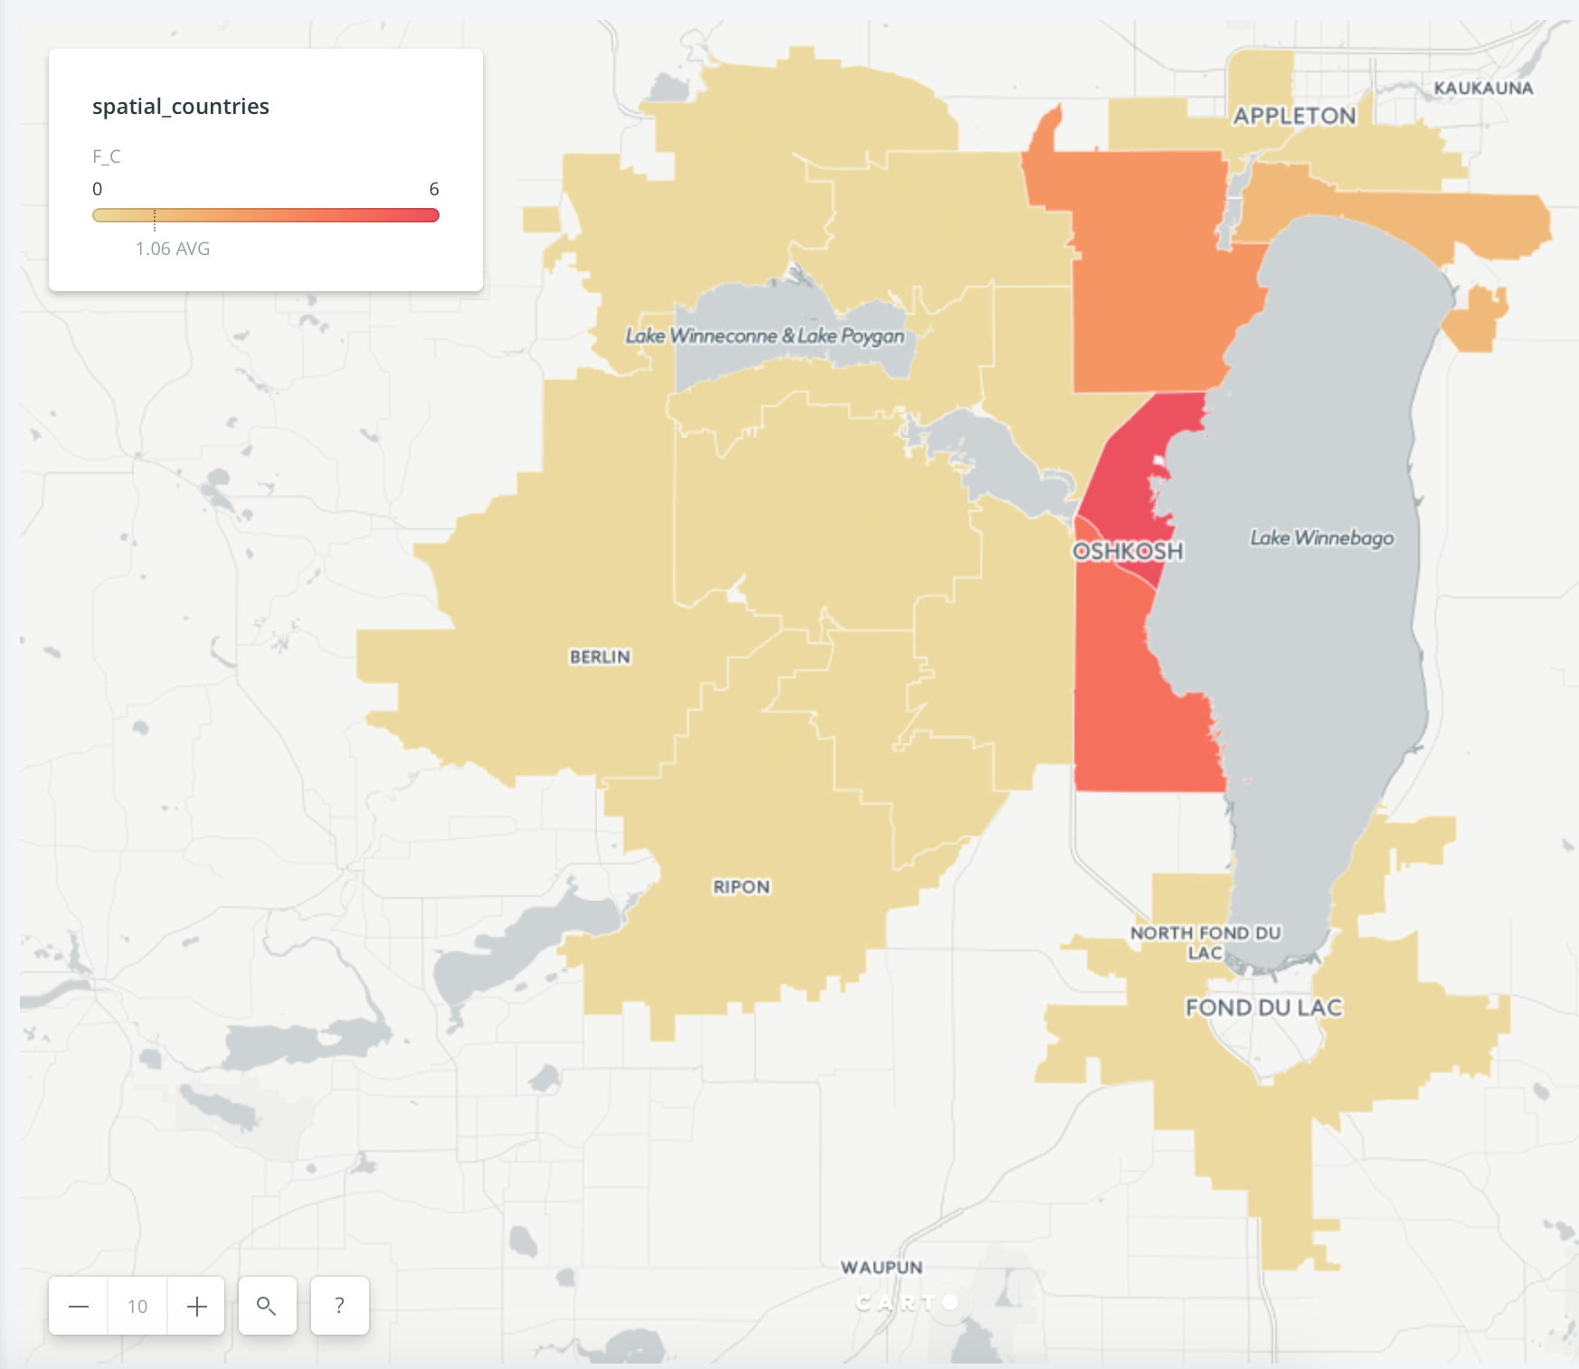
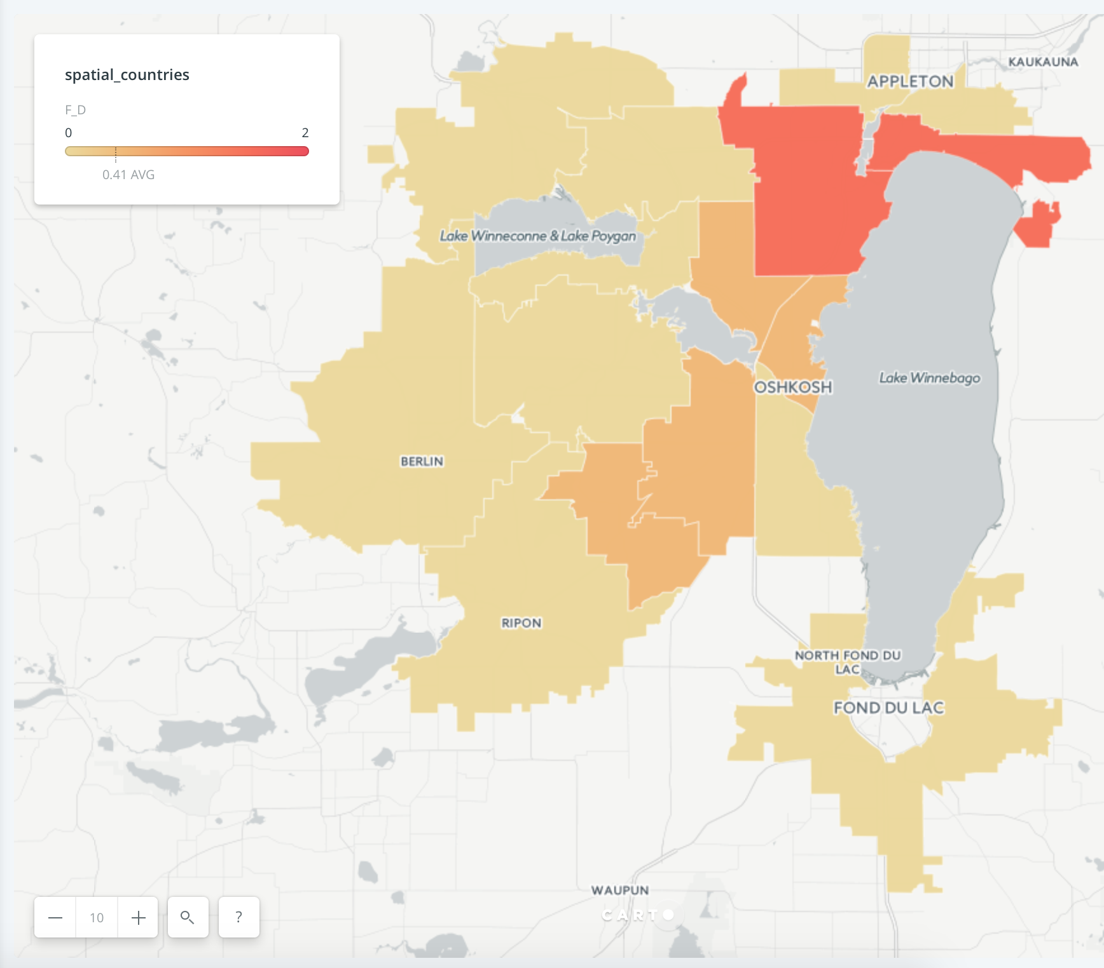
Severity - Class
Felony (F) - Class (B) + Class (C) + Class (D)
F_B - 1st Degree Child Sexual Assault | Under 13 Contact | (2) in OshKosh
F_C - Second Degree Sexual Assault | (6) | Maximum in OshKosh
F_D - Child Enticement | (2) | Change in Trend - Not in OshKosh

Slide 12
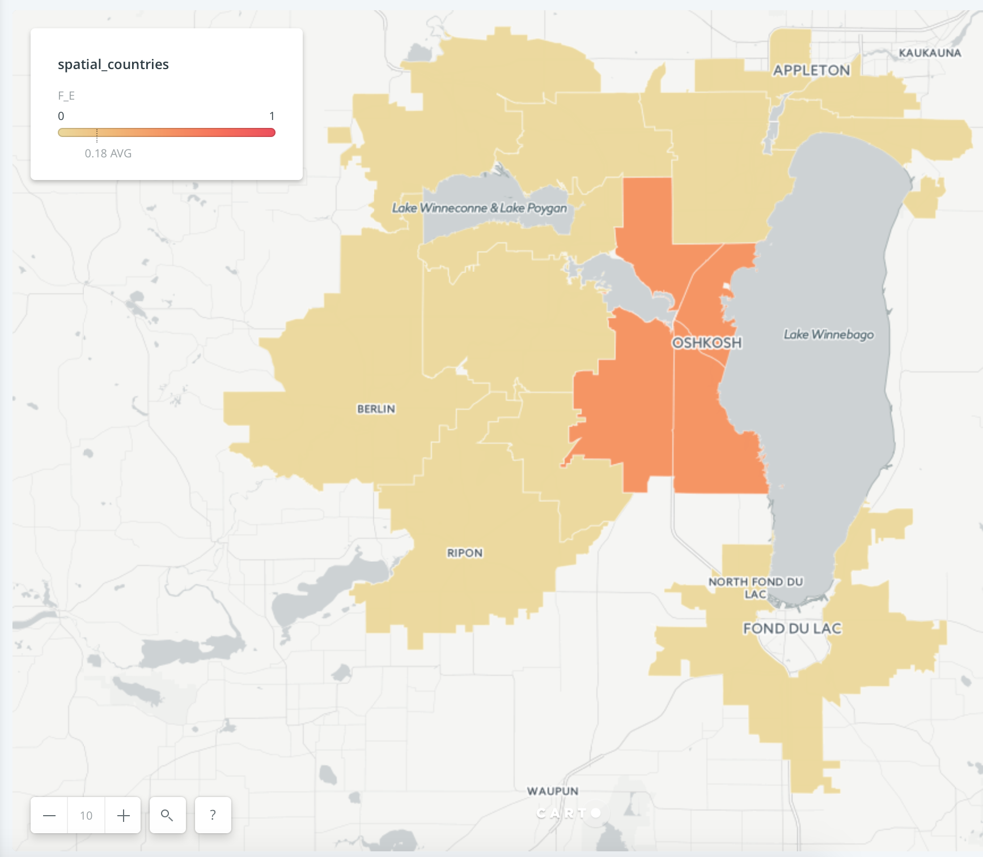
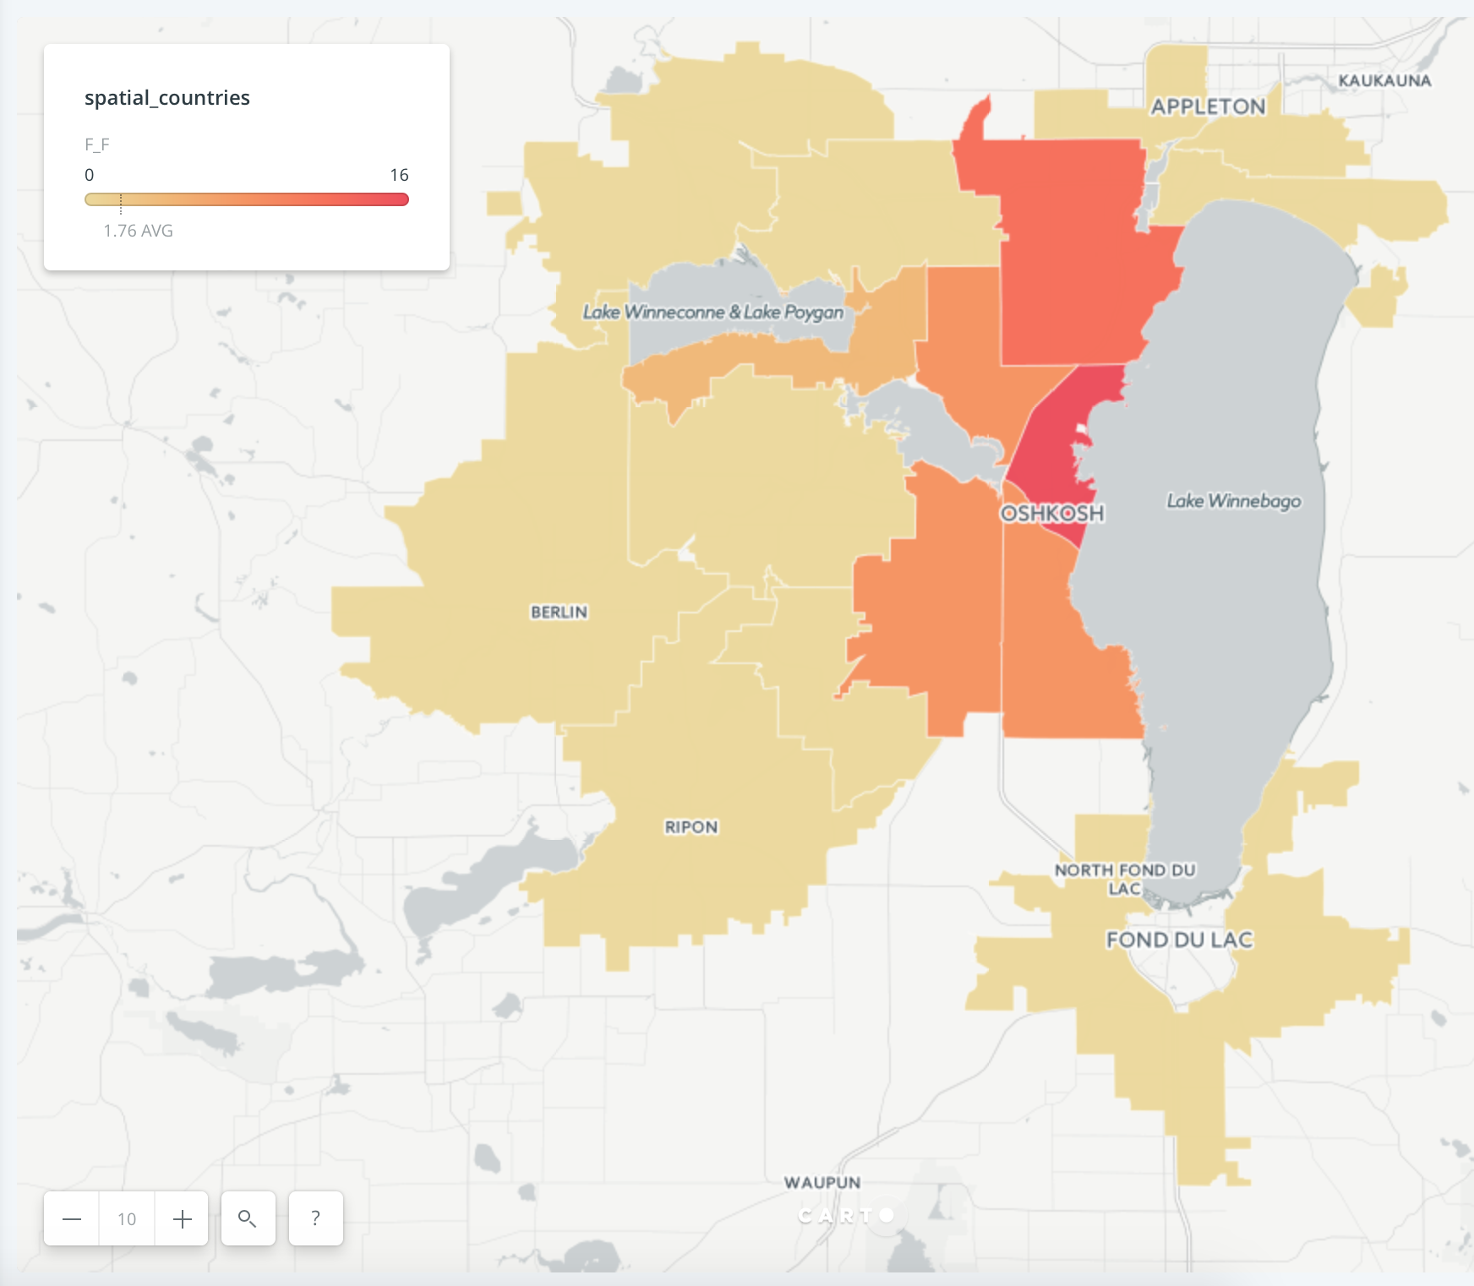
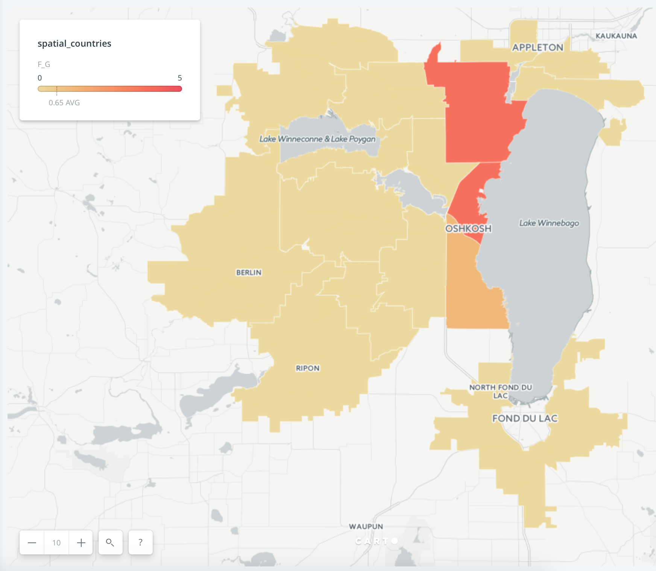
Severity - Class
Felony (F) - Class (E) + Class (F) + Class (G)
F_E - Drug Manufacturing | (3 - 10 grams) | (1)
F_F - Burglary-Building or Dwelling | (16) - Third Highest Counts
F_G - Third Degree Sexual Assault | (5)

Slide 13


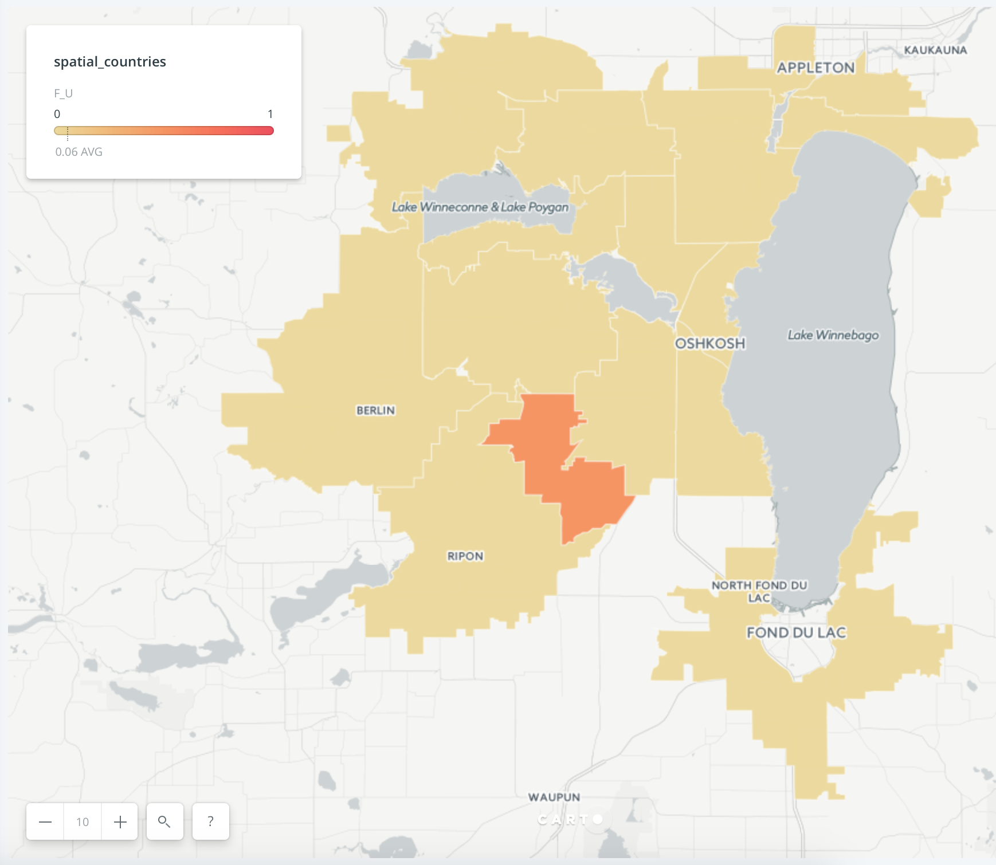
Severity - Class
Felony (F) - Class (H) + Class (I) + Class (U)
F_H - Uttering a Forgery | (54) - Highest Felony Counts
F_I - Possession of Methamphetamine | (20) - Second Highest Counts
F_U - Operating while Intoxicated | (1)

Slide 14
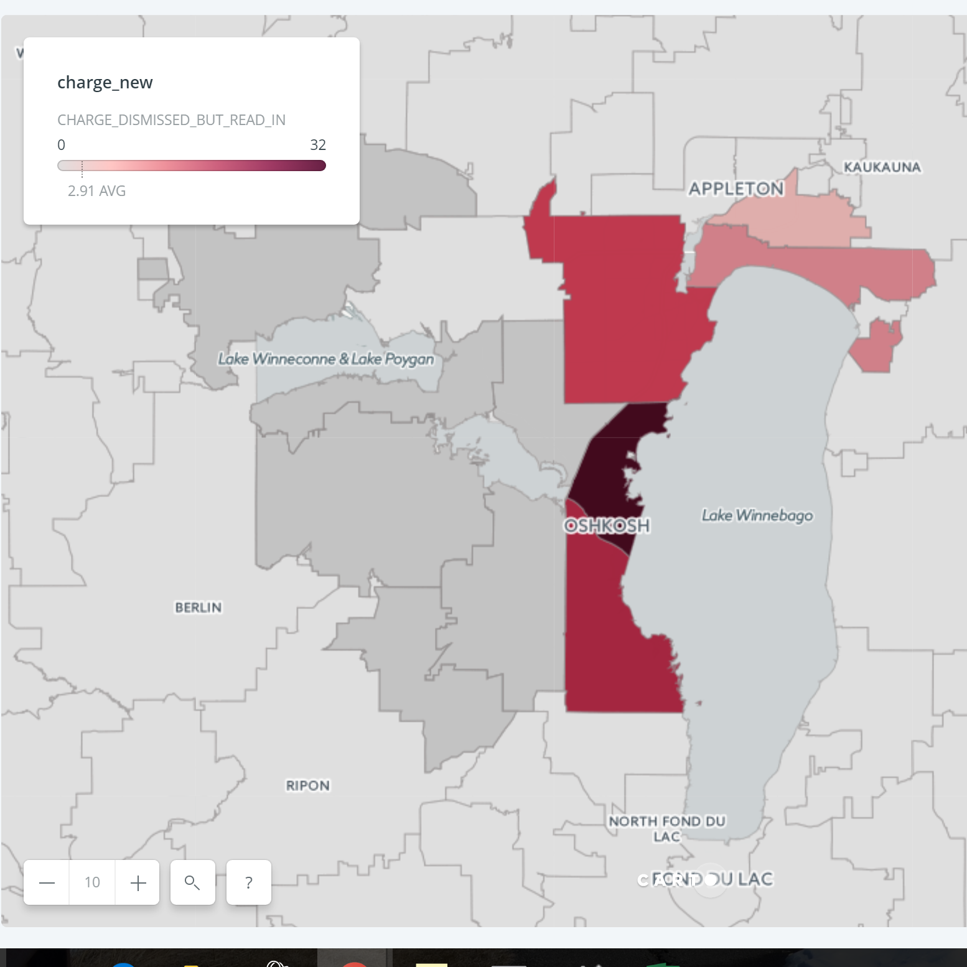
Cases
Cases for which Prosecution has been issued.
How Charge_Disposition varied across ZipCodes
OshKosh has the highest Charged_Dismissed_But_Read_In
(Read it in Court but formally dismissed)

Slide 15
Prominent Cases
You already saw this on the very first slide
We start with our best work
This can also be used as a tool by the DA’s office and BetaGov

Slide 16
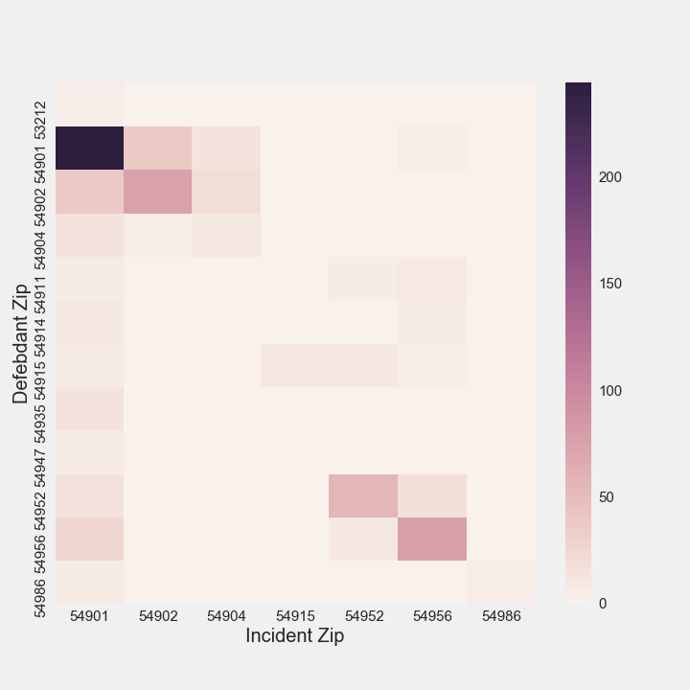
Heat Maps
Oshkosh is a very dangerous place to live.
Whatever you do - please look into our results and then plan your trips.

Slide 17
Conclusions and Future Work
Develop clustering techniques to make up the missing data.
Apply logistic regression to build a predictive model due to the large amount of categorical data.
Predictive Model based on the categories and see how they change based on Gender or Race (Half Completed but a little more time would have been perfect)

Slide 18
Thank You

